Slide 1

CV Review Graph Data Base Concepts Learning Presentation
Tamás Smahajcsik-Szabó
2024.09.05.

Slide 2
CV Review Technical, Programming and Analytical Skills
AVAYA - Senior Research Scientist (2019-2024)
Programming: R, Python, Java, Javascript, Typescript, CSS, HTML, React.JS, D3.js, git, Docker, Kubernetes, AWS, Azure, Figma, Power BI
Projects: Applied Natural Language Processing and Graph Analytics in Contact Center solutions, chatbot augmentation, dashboard- and frontend development; Applied Machine Learning for dialog and conversation analysis
Vodafone – Customer Experience (CX) Data Analyst (2017-2019)
Programming: R, Python, Microsoft Office Suite, SQL,
Projects: Applied NLP, Sentiment Analysis, Report Automation and Ad-hoc reports on CX data, predictive modeling for NPS and other UX metrics.
IBM – Business and Data Analyst (2016-2017)
Programming: R, BREX, DAX, PowerQuery, SPSS Statistics, SPSS Modeler
Projects: Process Automation and Reporting, Attrition Modeling and Employee Satisfaction analytics
Research Associate (Eötvös University of Sciences, Emotional Regulation Research Group) (2018-present)
Programming: R, Python, Markdown, SPSS tools
Projects: Academic research, data visualization, custom library development, statistical data analysis (Bayesian statistics, network sciences, Structural Equation Modeling).

Slide 3
CV Review Teaching skills, UI/UX, Behavioral Sciences
AVAYA - Senior Research Scientist (2019-2024)
Vodafone – Customer Experience (CX) Data Analyst (2017-2019)
Internal business reviews, prezentations, conferences
IBM – Business and Data Analyst (2016-2017)
Educational plan for Agile squads on processes, process automation and methology
Research Associate (Eötvös University of Sciences, Emotional Regulation Research Group) (2018-present)
In-person, online and class room teaching experience, individual research and analytical supervision, participation in educational programmes, and conferences.
Develop an API to conduct software based psychological quantitative content analysis
Knowledge Transfer and internal presentations on projects and skills (data analysis, data science, SAS, and React.js)
UI/UX design in Figma and UX/Accessibility
Peak Financial Services (2024-present)
Appied behavioral science to design an elearning tool for adolescents on financial education
Set up UX metrics and analysis plan for user behavior modeling
Business Coach Kft. (2012-2013)
Preparation of learning material (presentation, videos and additional tools) in multiple languages for coaching classes.

Slide 4
Graph Database Concepts A Learning Design
Graph Database Basics
The graph structure

Slide 5

Introduction
The following learning design is intended to represent a course in Data Science, and assumes the audience has already participated in the preceeding sessions.
With this assumption, intermediate level statistical, R- and Python programming skills are needed for this course.
The goal of this course to introduce the audience with applied, hands-on experience on graph databases.
At least, introductory level of understanding of graph theory or graphs is assumed.

Slide 6
Network Science Learning Design Overview
Introduction to NeworkScience
Mathematical notation
Statistical Network Analysis
Graph Descriptives
Quantifying a graph
Graph Databases
Graphs as data structures
Real life use cases
Basic Concepts of Graphs
Real life use cases
Centrality
Density
Real life examples
Querying
Database management
Loading
Graph Algorithms
Influence
Community
Articulation
Beyond centrality and degree
Real life problems
Anomaly detection
Nodes and Links
Part of a Data Science Course
Covered in the Example
Assessments and Interactions
Interactive online canvas (e.g. O’Reilly) with forum, chat, resources, polls and tasks.
Tasks: online, real-time and home work
Activities: online, real-time
Code challenges: R, Python, Javascript resources with solutions

Slide 7














Agenda Graph Basics – Graph Data Structures
Task: Install Neo4J
Introduction to Neo4J
Node Properties
Edge Types
TNG sample dataset
Task: Enriching a graph database with propeties
-BREAK-
Graph Algorithms
Communities and Centrality
Links, resources
Poll How experiences you are with graph analytics?
Not at all.
52%
Some exposure.
17%
I’m further along.
31%
Chatroom
23
A.T.: Hi!
E.G.: Hello from Spain!

Slide 8

Graphs as Data Structures
Graphs, networks are integral parts of our lives.
Common examples of interconnected entities are home network systems, the social network around us, or more metaphorically speaking families and friends – personal relationship (people interconnected by bonding).
Density
Community
Size
Order
Friends
Key Phrases:
Node (vertex)
properties
Edge (link, arc)
type [1]
direction
properties
Person
Kid
Person
Kid
Person
Adult
:HAS_LESSON
Nurse
Person
Kid
{ weeklyLesson: 7}
{ageGroup: d}
{ageGroupLabel: “Kid”}
{ weeklyLesson: 5}
{lessonDuration: 45}
Person
Kid
:CONTRACT
Notation is Cypher syntax used in many graph database applications.
Task: Can you recall any structures, phenomena, or problem from your daily (work) experiences that can thought of graphs?
Company

Slide 9
Timed exercise!
15:00
Task: Install Neo4J
Following the attached OS-specific guidelines, install Neo4J on your system.
Links, resources
Links, resources

Slide 10
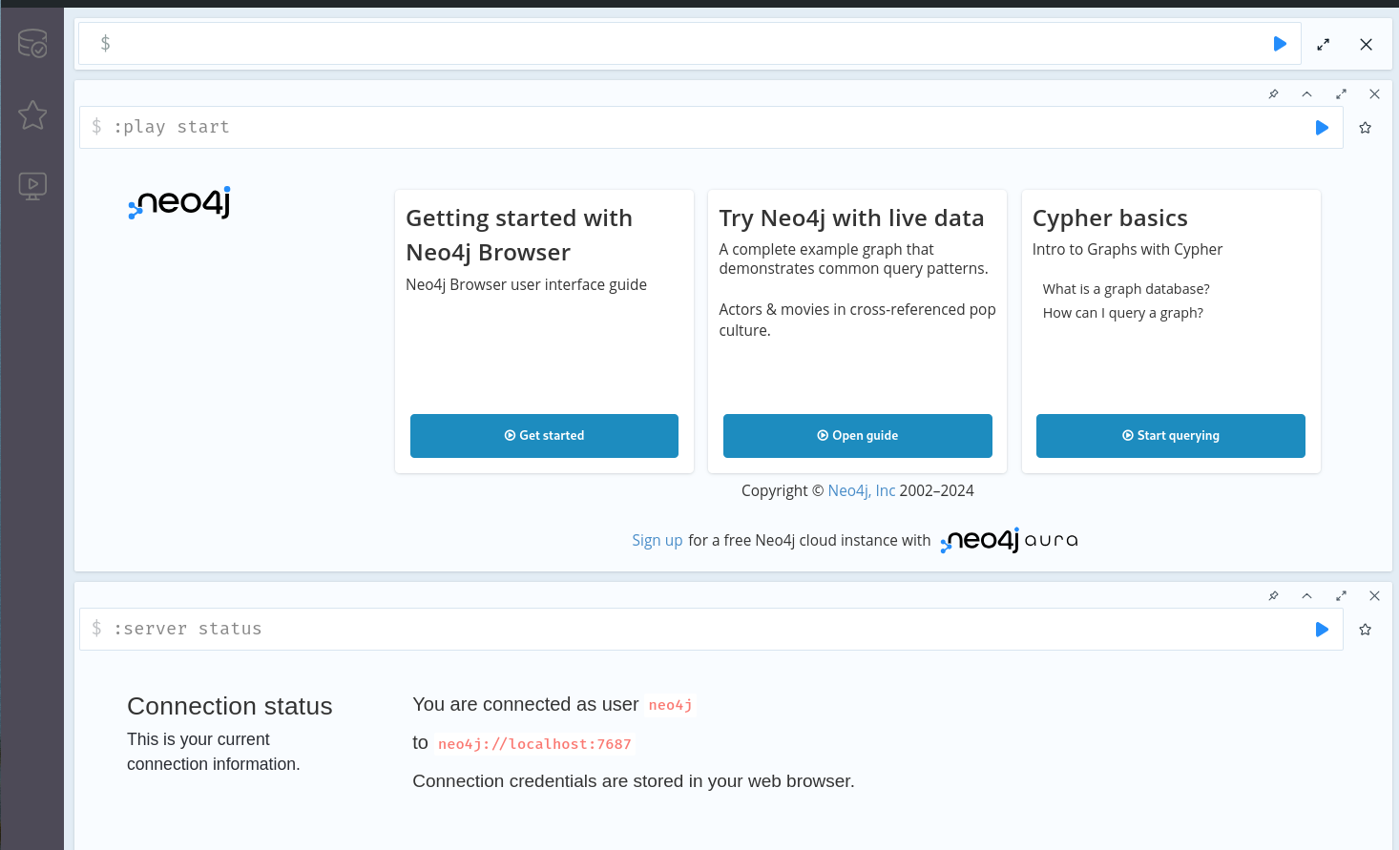
Neo4J: The Graph Database
Poll Have you had any difficulties with the Neo4J installation?
We will use Neo4J for local graph database demonstration.
We will check credentials and the initial setup for Neo4J by navidating to http://localhost:7474, the default port for the GUI.
Set up you user credentials you will use to connect for authentication.
Check if the server is running well and you can you can get some built-in toy examples running.
It’s up and running.
98%
I need help!
2%
Task: If you are done with the initial setup, use your preferred scripting language, and install Neo4J drivers.
For Python 3.X, pip install neo4J install the default, official driver.
For R 4+, I recommend the neo4R package from CRAN or Github.

Slide 11
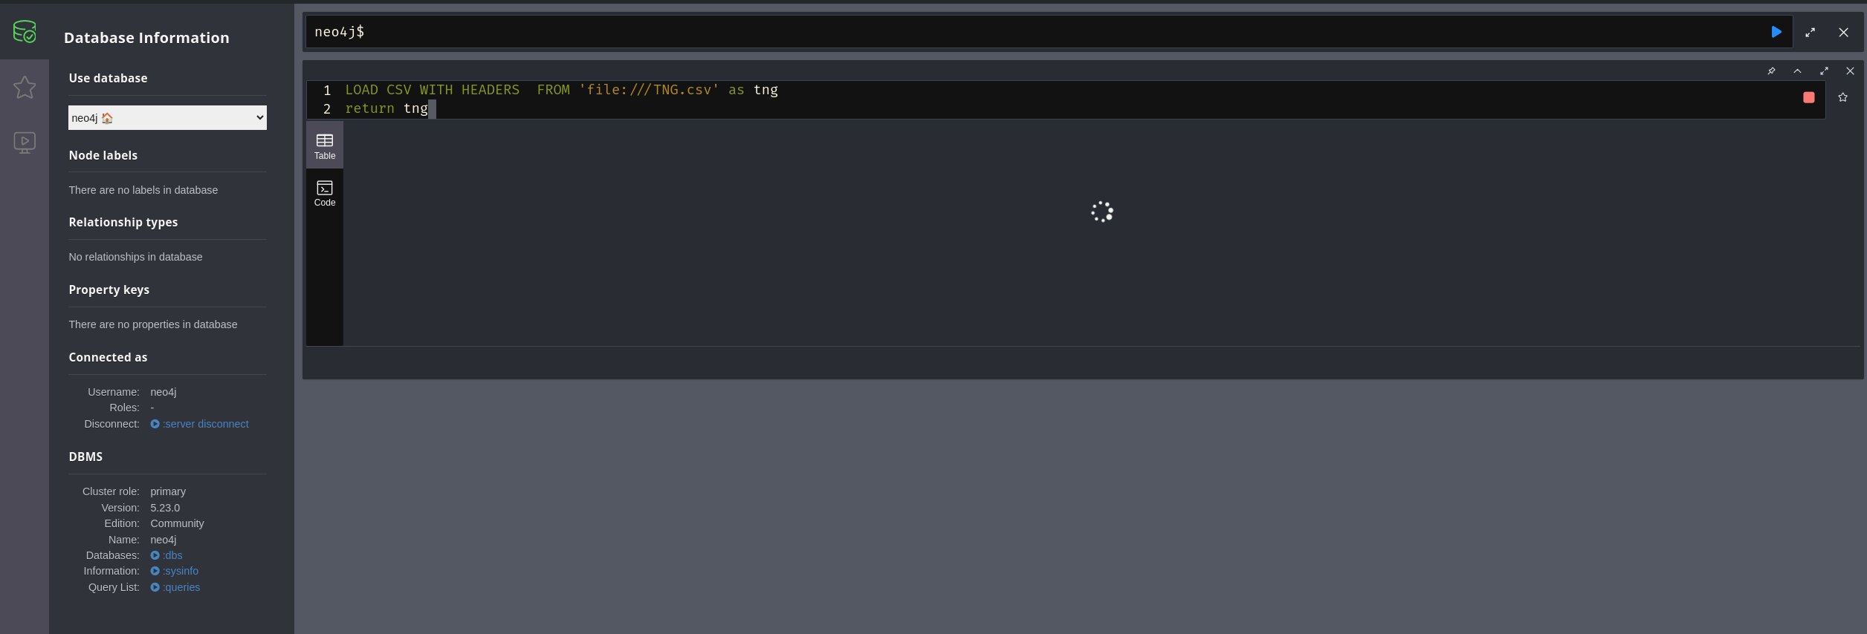
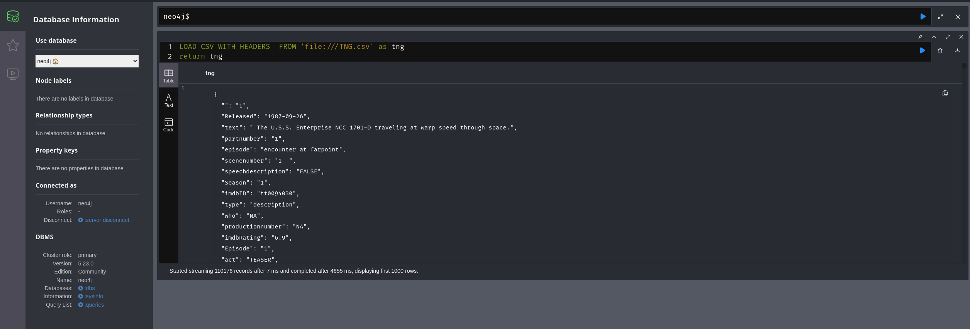
A sample data: TNG
Links, resources
We will use a subset of the TNG data to demonstrate loading CSV data into Neo4J.
As we load the data into the database, we declare and define nodes with properties, and the links (relationships) between them.
We can use this data to do some ad-hoc queries. The data covers the scripts (dialogs and narration) and scene structure of the series Star Trek – The Next Generation. For the demonstration’s sake, we will use season 3’s data.
The data is tabular, and contains 110 thousand records on scenes of the an espiode from the series, broken down into acts, scenes and parts. We see characters, what they say and what other characters are present in that scene or part of the scene.
Task: Get the data from the Github page: https://github.com/RMHogervorst/TNG
Activity:
Use the attached script in the Neo4J GUI to load the data. It can take a while, but for season 3 you will get some 2900 nodes and 20.000 relationships into a local database.
Task:
The repository is an R package, make sure to install the package, and read in the RData file.

Slide 12
A sample data: The LOAD query
Links, resources
LOAD CSV WITH HEADERS FROM 'file:///TNGAbbr.csv' as row
WITH row, split(row.characters, ',') AS characterList
MERGE (who:Character {name: trim(row.who)})
MERGE (scene:Scene {id: trim(row.scenenumber)})
MERGE (episode:Episode {title: trim(row.Episode)})
MERGE (season:Season {number: trim(row.Season)})
MERGE (who)-[:APPREARS_IN_SCENE]->(scene)
MERGE (who)-[:PLAYS_IN_EPISODE]->(episode)
MERGE (who)-[:PLAYS_IN_SEASON]->(season)
MERGE (text:Text {content: row.text})
MERGE (who)-[:SAYS]->(text)
MERGE (text)-[:SAID]->(scene)
FOREACH (characterName IN characterList |
MERGE (character:Character {name: trim(characterName)})
MERGE (character)-[:APPEARS_IN_SCENE]->(scene)
MERGE (character)-[:PLAYS_IN_EPISODE]->(episode)
)
MERGE (scene)-[:PART_OF_EPISODE]->(episode)
MERGE (episode)-[:SCREENED_IN]->(season);
We load the CSV file, located on the default import path.
We define the Character node and its name property.
We define Scenes, Episodes and Seasons with their respective properties.
We enrich the database by adding relationships to our existing nodes, characters who appear in a scene, episode and at the top level, in a season.
As the data contains textual data, we define Text and relationships for a Person who SAYS the text, and the Scene where the Text was SAID.
By iterating over the characters who appear in a scene beside the speaking character, we add their relationships with Scenes and Episodes.
In final chunk of code, we add relationships to define for a scene part of an Episode, and an Episode screened in a Season.
Question: Reading this Cypher syntax, can you recognize SQL?

Slide 13
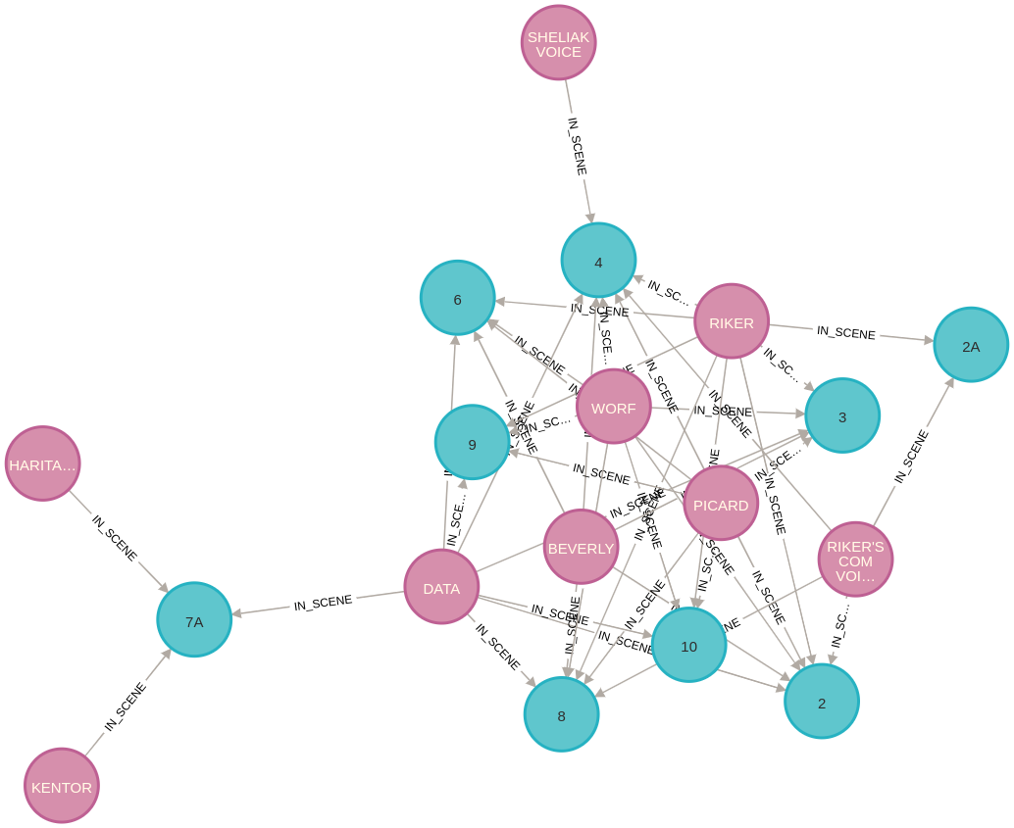
The result of a graph query
Links, resources
Characters in numbered scenes of a selected Episode by the first 25 records in the database. Two nodes (Character and Scene) and one relationship (“:IN_SCENE”) have been used.

Slide 14
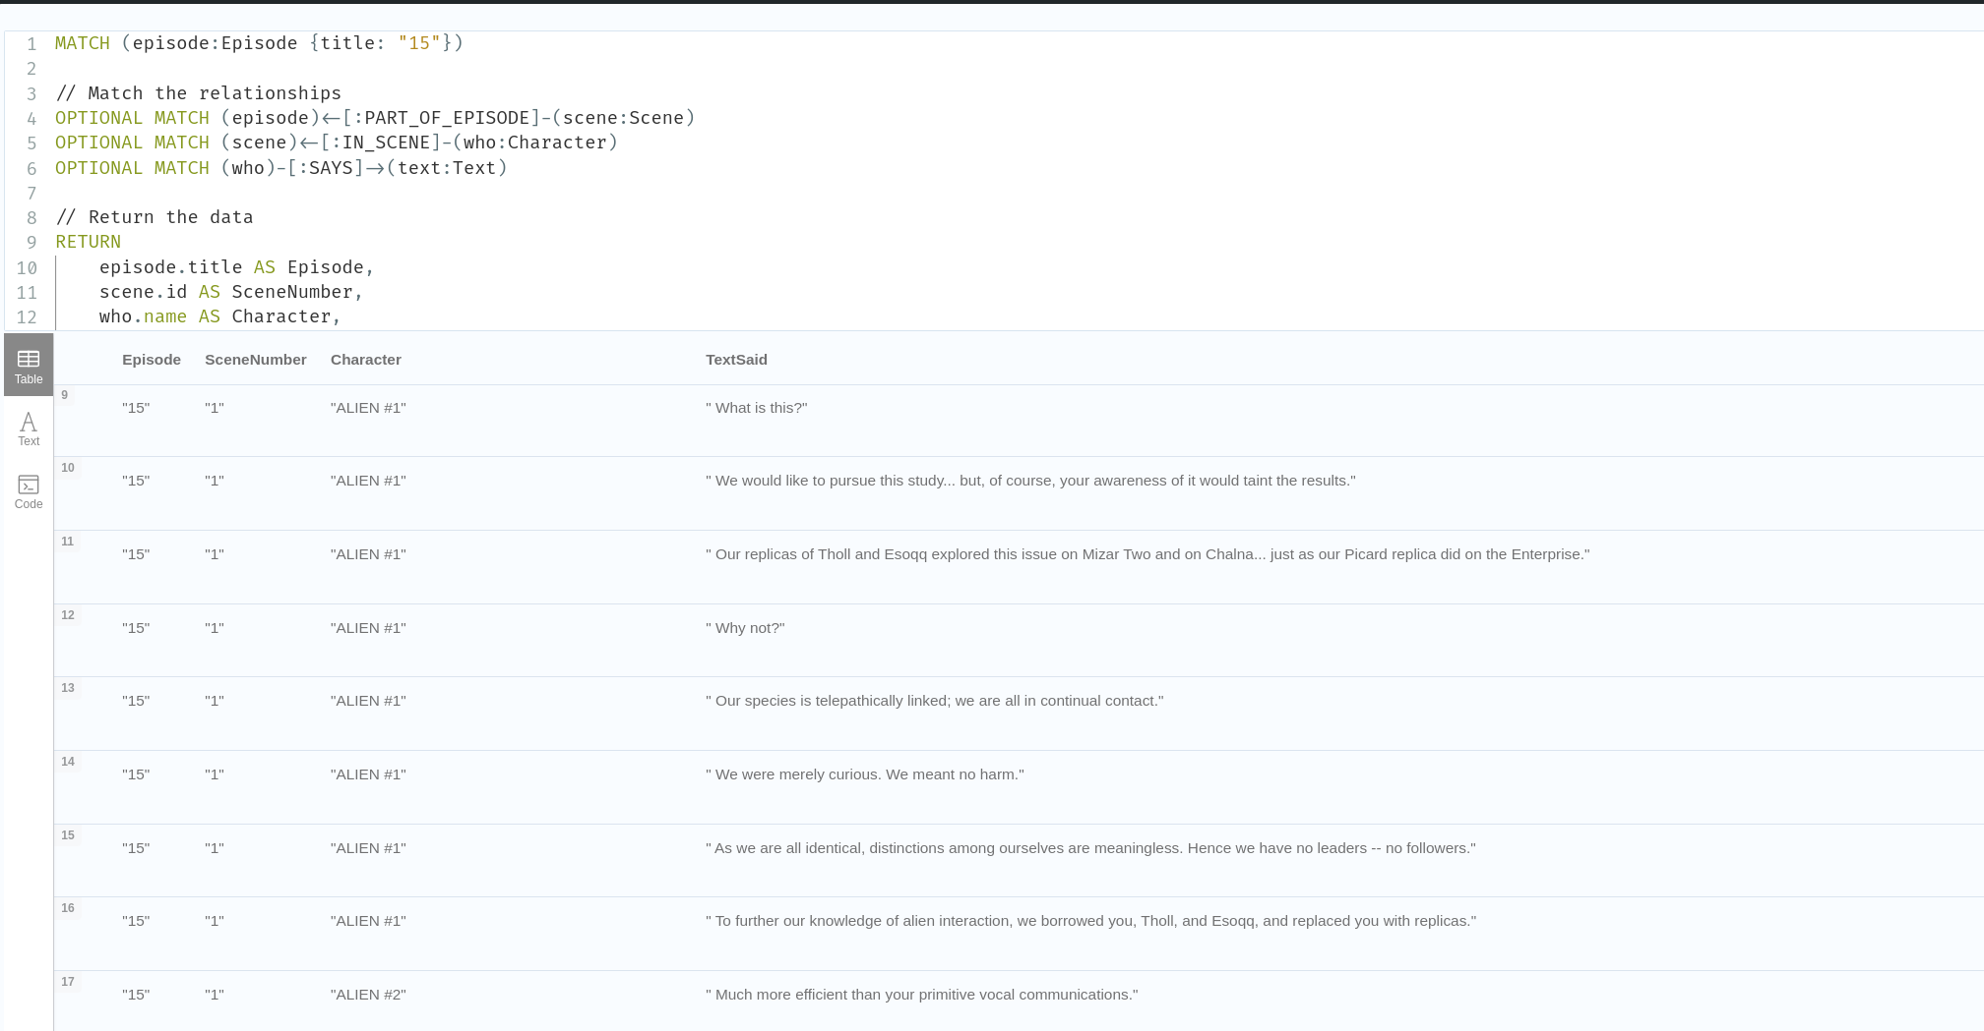
The result of a graph query for dialogues
Links, resources
In this data query, we were interested in Episode #15’s dialogs, the Character whos SAID the scene and in which Scene the character was in (“IN_SCENE” relationship).

Slide 15
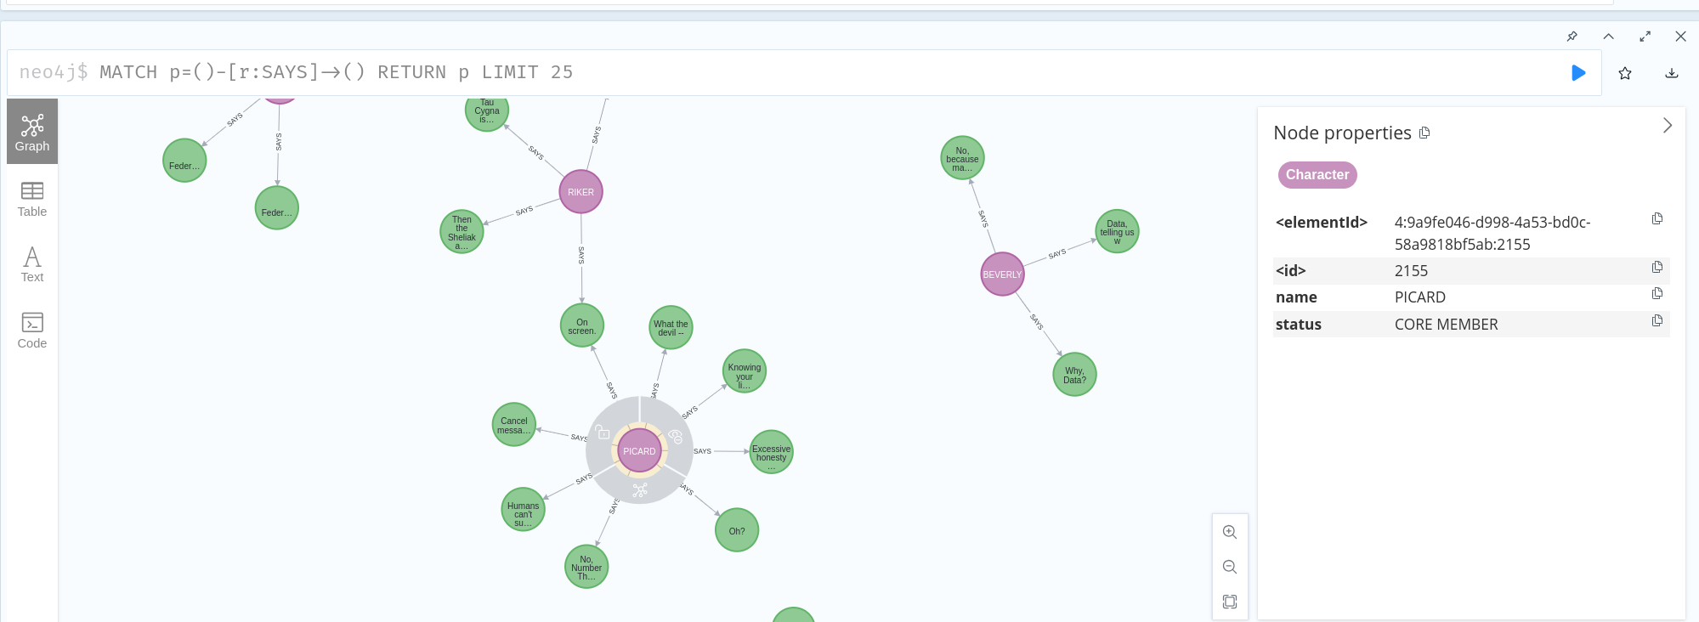
Update nodes with additional properties
Links, resources
// Define the list of core members
WITH ["PICARD", "RIKER", "DATA", "WORF", "GEORDI", "TROI", "BEVERLY", "WESLEY"] AS coreMembers
// Match all characters
MATCH (c:Character)
// Check if the character's name is in the coreMembers list
SET c.status = CASE
WHEN c.name IN coreMembers THEN "CORE MEMBER"
ELSE "SUPPORTING"
END;
We define an Array of Character names
If we have a match against this Array we add a new “status” property as “CORE MEMBER”.
Task:
Think of other properties based on ALLIEGANCE, SPECIES or other information to enrich the database and send in your solution in!

Slide 16
Thank you for your attention!
And now it’s time to have a BREAK!

